Slide 2


Slide 3

Contribution

Slide 4
Main Menu(Candidate Side)
Explain about the task
Put screenshot of program

Slide 5
Option 3 (Voter Side)

Slide 6
Sqlite 3 (Candidate and Voter Side)

Slide 7
Candidate ID (Candidate Side)

Slide 8
Option 2 (Voter Side)

Slide 9
Division (Candidate Side)

Slide 10
Option 1 (Voters Side)

Slide 11
Option 2 (Candidate Side)

Slide 12
Option 4 (Voter Side)

Slide 13

Program Design

Slide 14
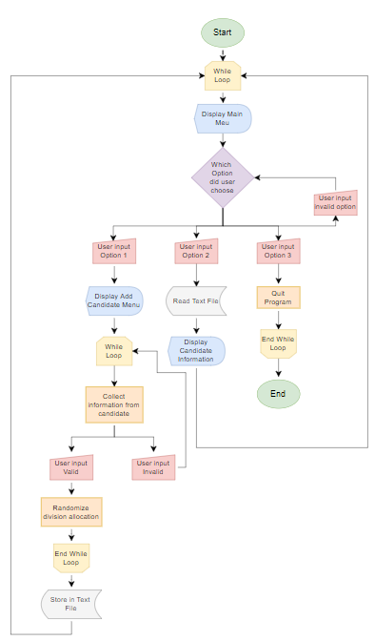

Slide 15
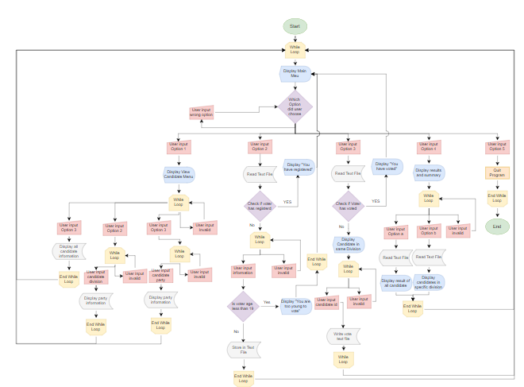

Slide 16

Enhancement of Program

Slide 17


Slide 18

Program Showcase

